Slide 1

Mini Project 1
February 2021
Jin Yang

Slide 2
Disclaimer
Past performance is no guarantee of future results.
The analysis presented in this presentation is to provide information on historical data and has no intention to provide any financial advice.

Slide 3
Background
The market capitalization of the Australian Securities Exchange has increased from $1.629 trillion as at December 2015 to $2.237 trillion as at December 2020 (ASX, 2021).
With a low cash rate of 0.10% (effectively from 2 December (RBA,2021)), many retail investors are investing more into Australian share market (Vickovich, 2020).
However, the market is risky, volatile and uncertain.
These investors may not outperform the market.

Slide 4
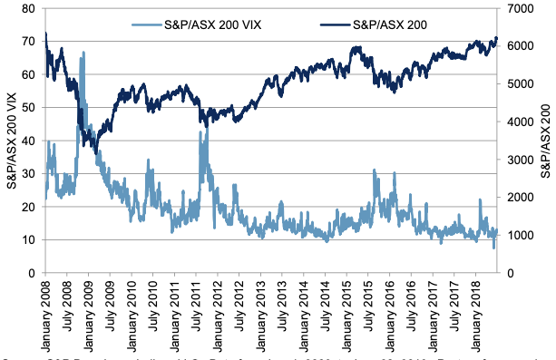
Market ASX200 index and volatility

Slide 5
Business Question
Is there a relationship between value investing criteria and share price?
Objectives
  To investigate the relationship between value investing criteria and returns.
  To examine the differences in the value investing criteria between the firms with positive and negative returns.

Slide 6
Pipeline
Data source
  Financials from Morningstar database (for the period 2011 to 2020)
  Share price from Yahoo Finance
Clean & Exploring
  Summary statistics and correlation matrix
Visualization
  Scatter plots and line graph
Hypothesize
  Based on positive and negative return companies
Build Models

Slide 7
Value investing criteria
Selected value investing criteria (based on Benjamin Graham’ criteria)
  Current ratio
    Current assets / Current liabilities
  Debt to Equity ratio
    Total debt / Total equity
  Earnings per share
    Net profit / Total number of shares
  Price to earnings ratio
    Share price / Earnings per share
  Price to book value per share
    Share price / (Total equity / Total number of shares)

Slide 8
Value investing criteria
Selected value investing criteria (based on Benjamin Graham’ criteria)
  Current ratio (greater than or equal to 1.5)
    Current assets / Current liabilities
  Debt to Equity ratio (less than 0.5)
    Total debt / Total equity
  Earnings per share (increase in EPS for the last two consecutive years)
    Net profit / Total number of shares
  Price to earnings ratio (less than 15)
    Share price / Earnings per share
  Price to book value per share (less than 1.5)
    Share price / (Total equity / Total number of shares)

Slide 9
Summary statistics (2011-2020)
 | count | mean | std | min | 25% | 50% | 75% | max
Return | 1,654 | 0.223 | 0.722 | -0.683 | -0.105 | 0.074 | 0.317 | 4.818
Current Ratio | 1,654 | 2.210 | 2.258 | 0.241 | 1.050 | 1.561 | 2.373 | 14.167
DE | 1,654 | 1.249 | 1.697 | 0.059 | 0.463 | 0.796 | 1.304 | 11.918
EPS | 1,654 | 0.478 | 0.857 | -1.312 | 0.082 | 0.253 | 0.570 | 4.796
PE | 1,654 | 17.177 | 42.315 | -175.893 | 9.314 | 16.372 | 25.382 | 229.993
PB | 1,654 | 3.251 | 3.547 | 0.390 | 1.142 | 1.917 | 3.717 | 18.755

Slide 10
Summary statistics by year
 |  | 2011 | 2012 | 2013 | 2014 | 2015 | 2016 | 2017 | 2018 | 2019 | 2020
Return | mean | 0.421 | 0.045 | 0.280 | 0.257 | 0.228 | 0.353 | 0.240 | 0.254 | 0.182 | -0.037
Current Ratio | mean | 2.433 | 2.271 | 2.036 | 2.312 | 2.164 | 2.186 | 2.315 | 2.213 | 2.137 | 2.056
DE | mean | 1.266 | 1.224 | 1.289 | 1.218 | 1.204 | 1.249 | 1.182 | 1.172 | 1.288 | 1.412
EPS | mean | 0.489 | 0.406 | 0.380 | 0.461 | 0.374 | 0.442 | 0.574 | 0.630 | 0.576 | 0.397
PE | mean | 13.759 | 14.073 | 18.366 | 13.171 | 10.409 | 19.658 | 18.749 | 24.097 | 22.513 | 14.549
PB | mean | 2.636 | 2.357 | 2.598 | 2.821 | 2.853 | 3.340 | 3.562 | 3.868 | 4.142 | 3.960
 | count | 146 | 152 | 156 | 159 | 165 | 172 | 177 | 182 | 186 | 159

Slide 11
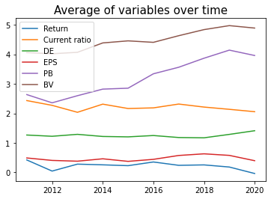
Trends
Based on average value of each year.
PE is excluded in this graph as its scale in y-axis is quite large compared to other features. Mean of PE is shown below.
 |  | 2011 | 2012 | 2013 | 2014 | 2015 | 2016 | 2017 | 2018 | 2019 | 2020
PE | mean | 13.759 | 14.073 | 18.366 | 13.171 | 10.409 | 19.658 | 18.749 | 24.097 | 22.513 | 14.549

Slide 12
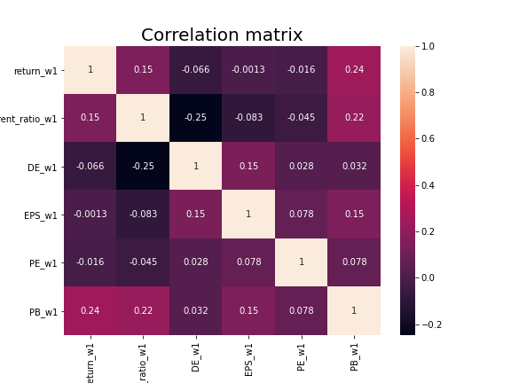
Correlation between key variables

Slide 13
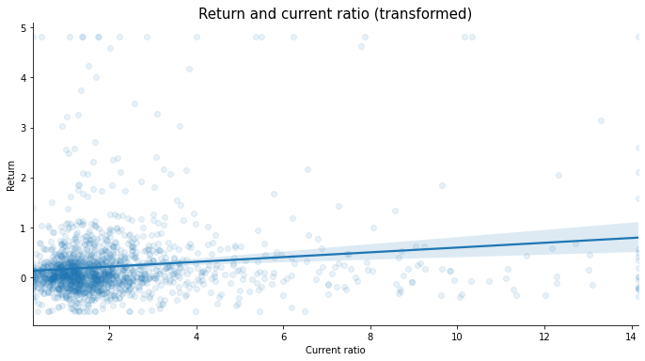
Return and Current Ratio

Slide 14
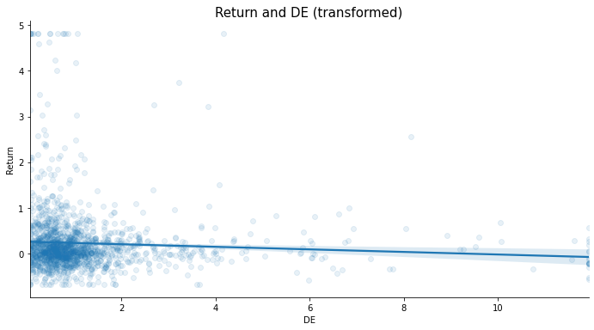
Return and DE

Slide 15
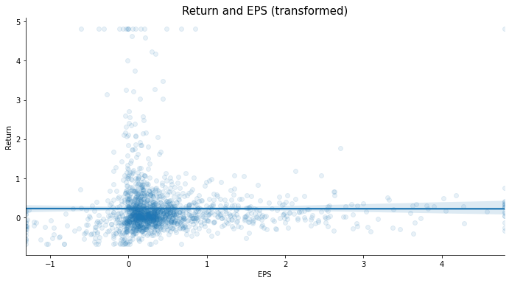
Return and EPS

Slide 16
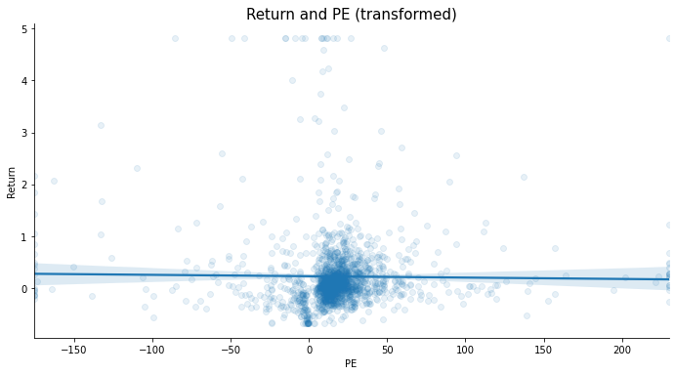
Return and PE

Slide 17
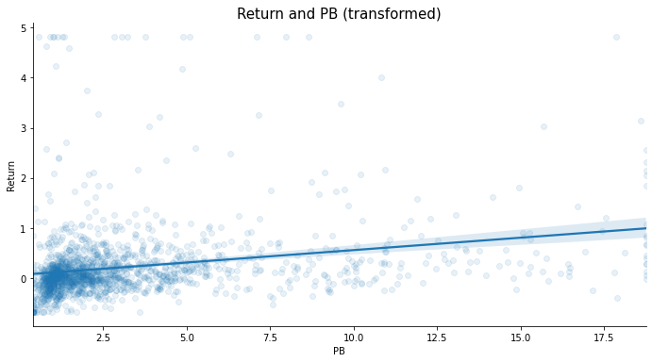
Return and PB

Slide 18

Hypothesis
Sample split into positive and negative returns
Hypothesis using Z-test:
Significance level: 5%
H0: There are no differences in value investing criteria variables between firms with positive and negative returns.
H1: There are differences in value investing criteria variables between firms with positive and negative returns.

Slide 19
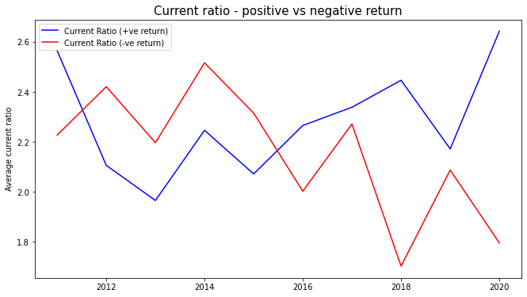
Current ratio

Slide 20
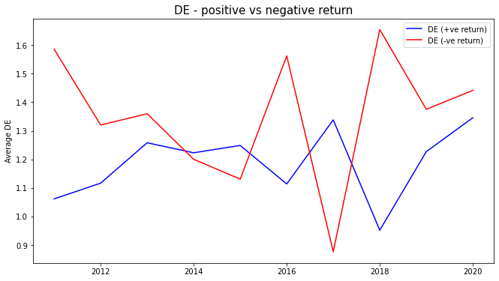
DE

Slide 21
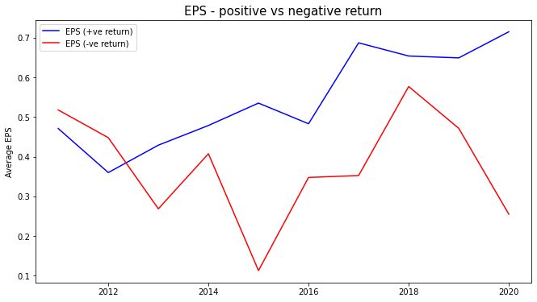
EPS

Slide 22
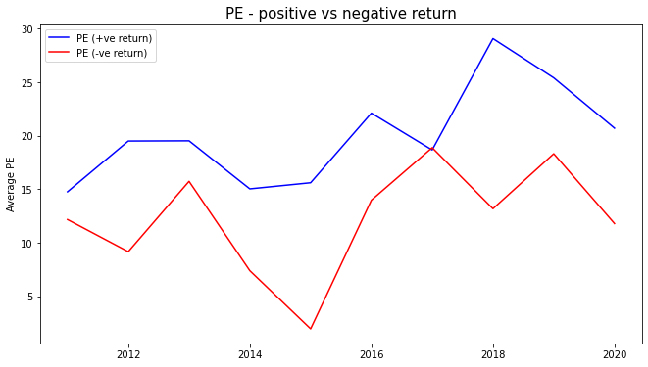
PE

Slide 23
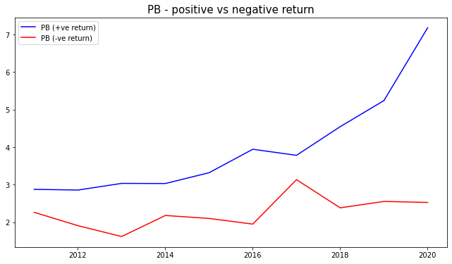
PB

Slide 24
Univariate test results
 | Firms with positive returns (mean) | For firms with negative returns (mean) | t-stats | p-value | reject (p-value < 0.05)
Current ratio | 2.265 | 2.124 | 1.243 | 0.214 | NO
DE | 1.181 | 1.356 | -2.047 | 0.041 | YES
EPS | 0.546 | 0.370 | 4.102 | 0.000 | YES
PE | 20.266 | 12.308 | 3.742 | 0.000 | YES
PB | 3.857 | 2.295 | 8.932 | 0.000 | YES
Observations | 1,012 | 642

Slide 25
Thought Experiment
Generating a portfolio using the value investing criteria and examine the returns for the past 5 years.
  Current ratio (greater than or equal to 1.5)
  Debt to Equity ratio (less than 0.5)
  Earnings per share (increase in EPS for the last two consecutive years)
  Price to earnings ratio (less than 15)
  Price to book value per share (less than 1.5)
Compare the cumulative returns of portfolio returns with ASX200 (ASX Code: XJO) from 2015 to 2020.

Slide 26
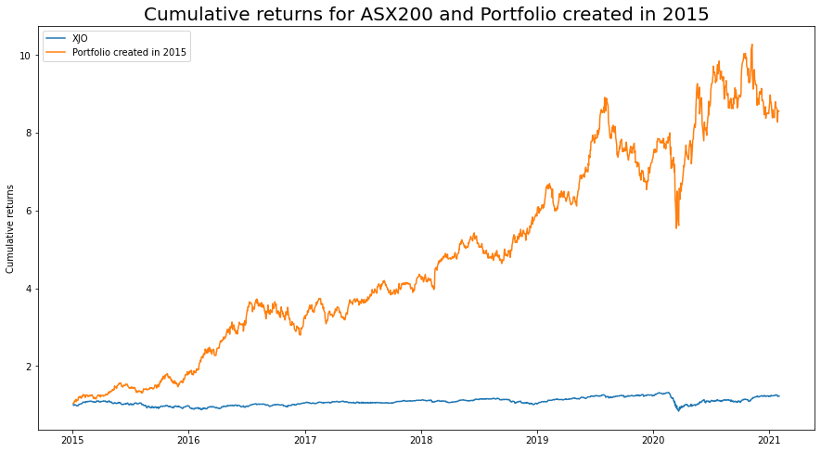
Comparison of cumulative returns between the value investing portfolio and ASX200

Slide 27
Summary
Findings
  Current ratio and PB are positively correlated with returns, whereas DE, EPS, and PE is negatively correlated with returns.
  Means of DE, EPS, PE, PB is statistically different between firms with positive and negative returns.
Limitations
  The sample consists of ASX200 stocks only.
  The return is based on the yearly share price.
  Timing differences between return and the financial information made publicly available.
Future research
  Develop and apply a predictive model (e.g., supervised learning).
  Further analysis including different types of industry.

Slide 28
Reference
ASX, 2021, Historical market statistics, ASX, viewed on 28th Jan 2021 (https://www2.asx.com.au/about/market-statistics/historical-market-statistics).
RBA, 2021, Cash Rate Target, Reserve Bank of Australia, viewed on 28th Jan 2021 (https://www.rba.gov.au/statistics/cash-rate/).
Vickovich, A, 2020, Investors ‘take a punt’ on Australia’s riskiest stocks, Australian Financial Review.

Slide 29
Thank you
Any questions?

Slide 30
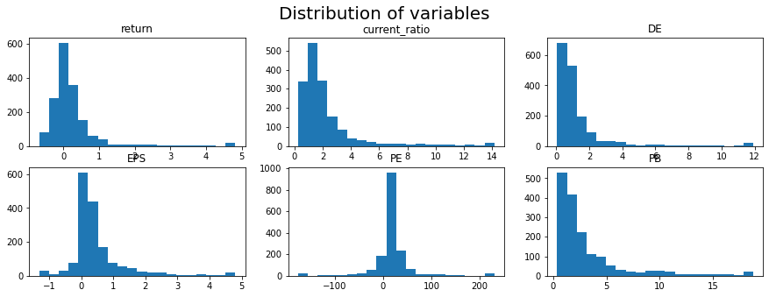
Appendix 1 – distribution graph (including transformed variables)

Slide 31
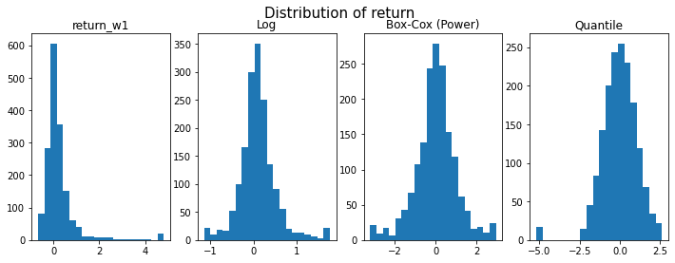

Slide 32
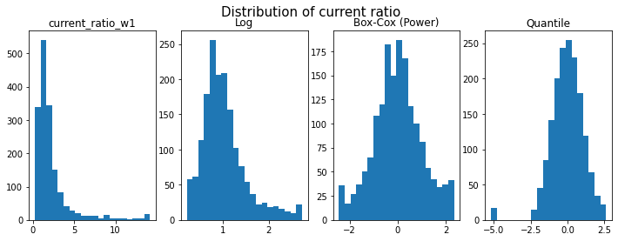

Slide 33
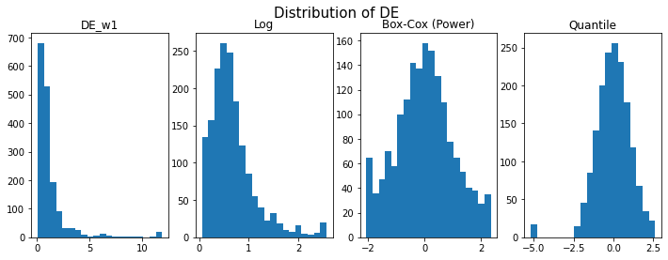

Slide 34
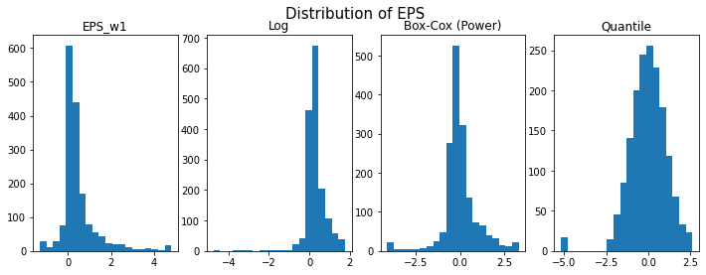

Slide 35
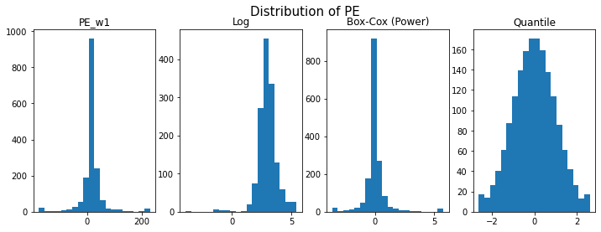

Slide 36
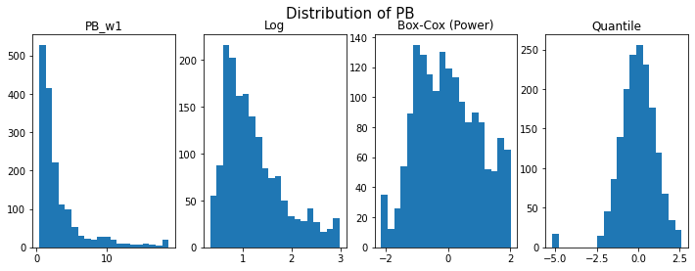

Slide 37
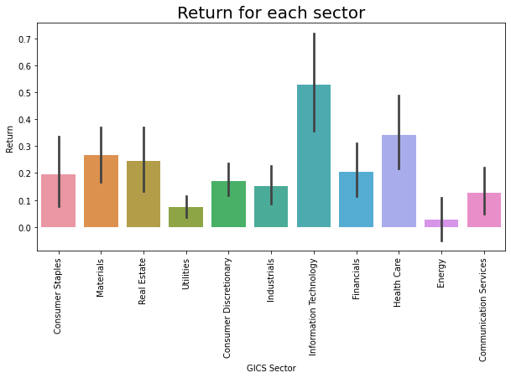
Appendix 2 – for each industry

Slide 38
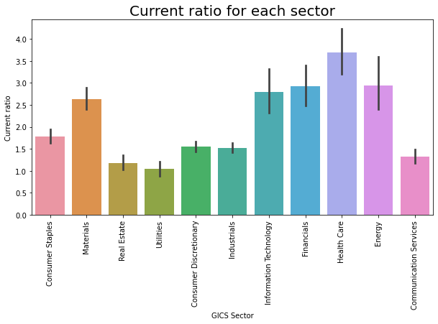

Slide 39
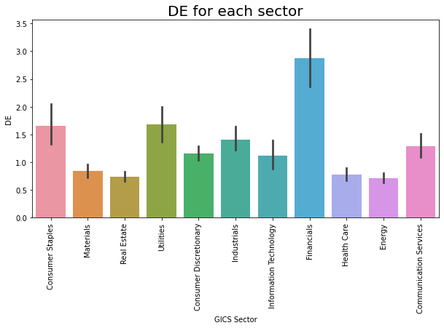

Slide 40
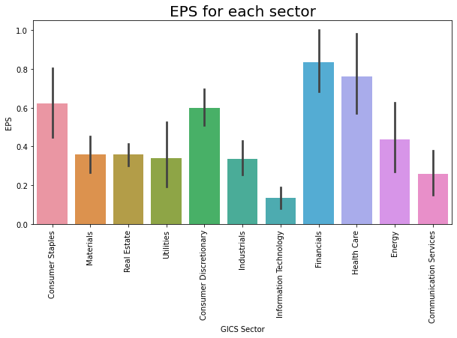

Slide 41
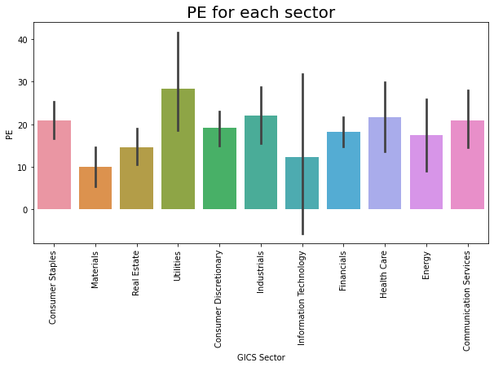

Slide 42
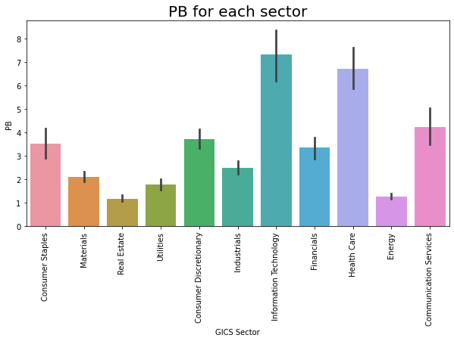

Slide 43
Appendix 3 – Scatter plots using transformed data

Slide 44
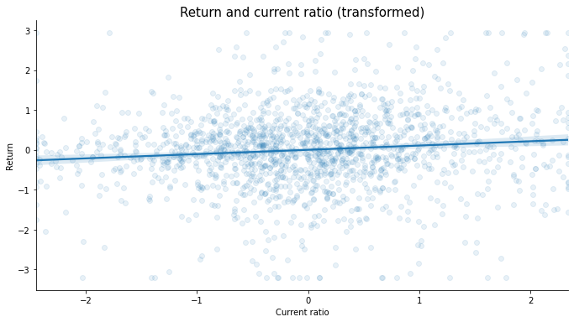
Return and Current Ratio

Slide 45
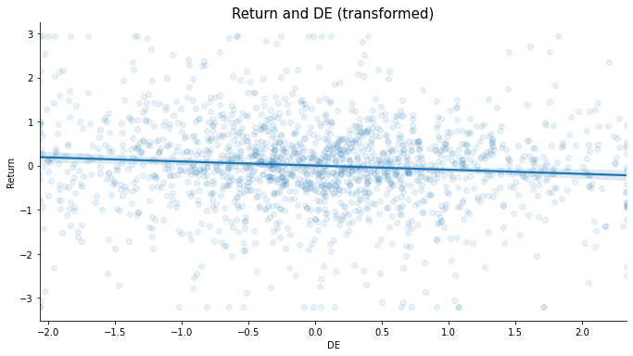
Return and DE

Slide 46
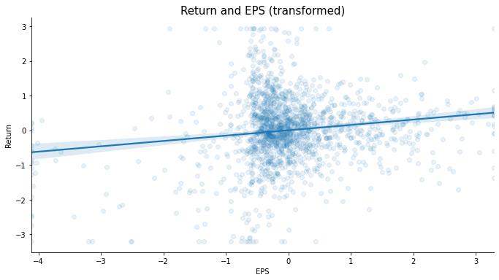
Return and EPS

Slide 47
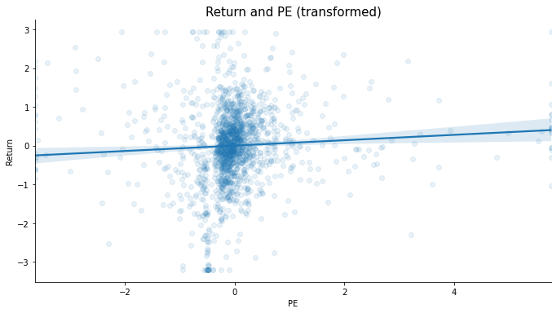
Return and PE

Slide 48
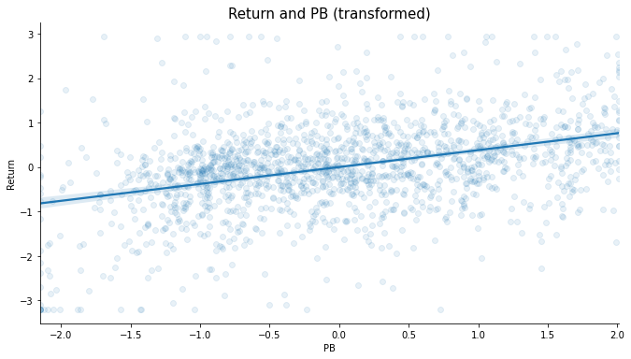
Return and PB

